Slide 1

Start-Up Global
Project By:
Ellen Wu
Nita Xiong
John Shen
Ashish Gupta

Slide 2

01
02
03
04
05
06
GDP Per Capita
New Business Registered
Cost to
Register
Lower
Secondary
Rate
Procedures Required
Percentage of Urban Population
07
08
Time
(days)
Sex Ratio

Slide 3
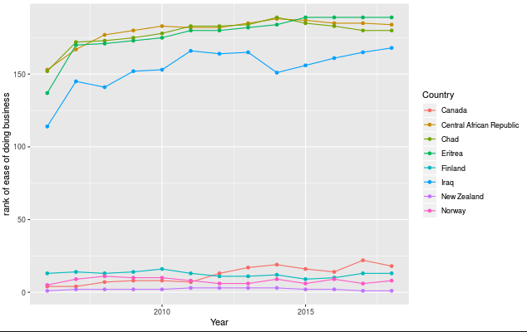
Exploratory Analysis

Slide 4
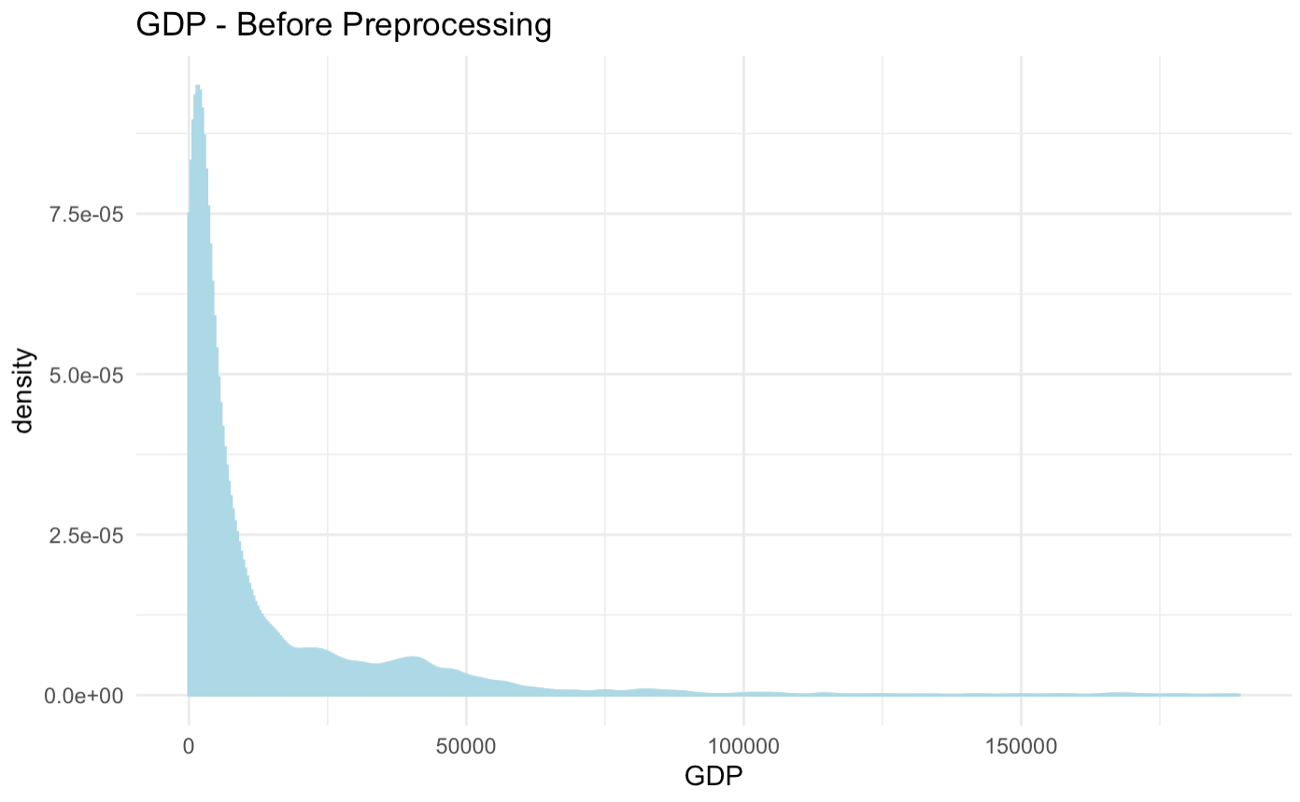
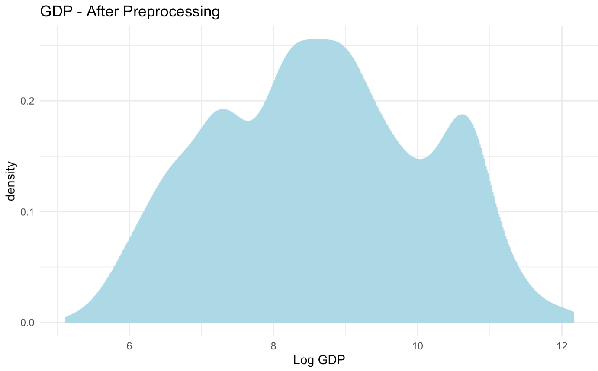
Preprocessing Data
Before
After

Slide 5
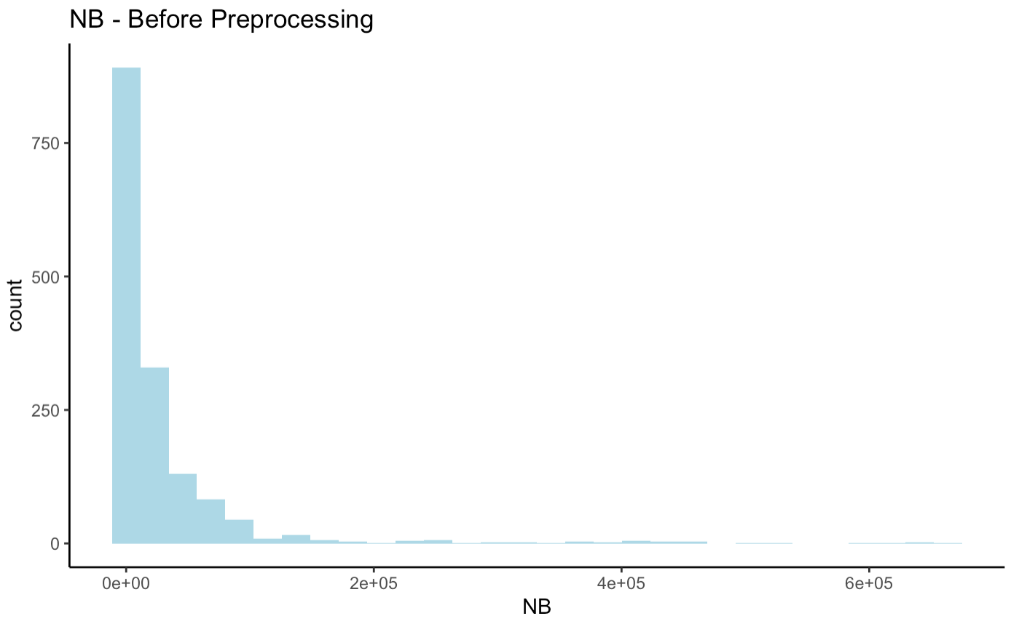
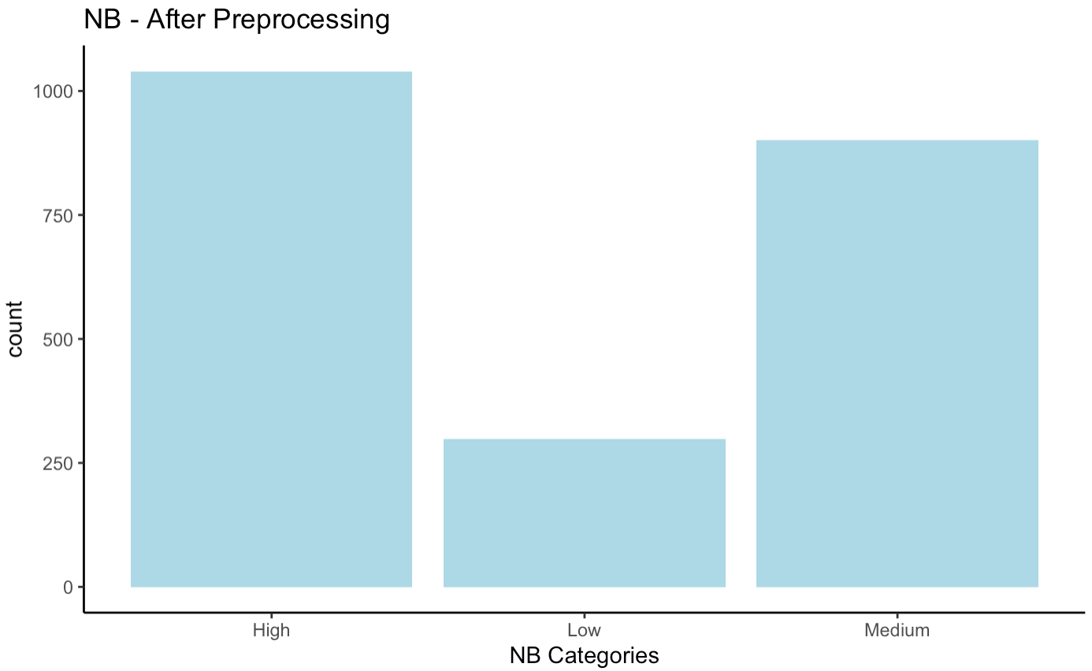
Preprocessing Data
Before
After

Slide 6
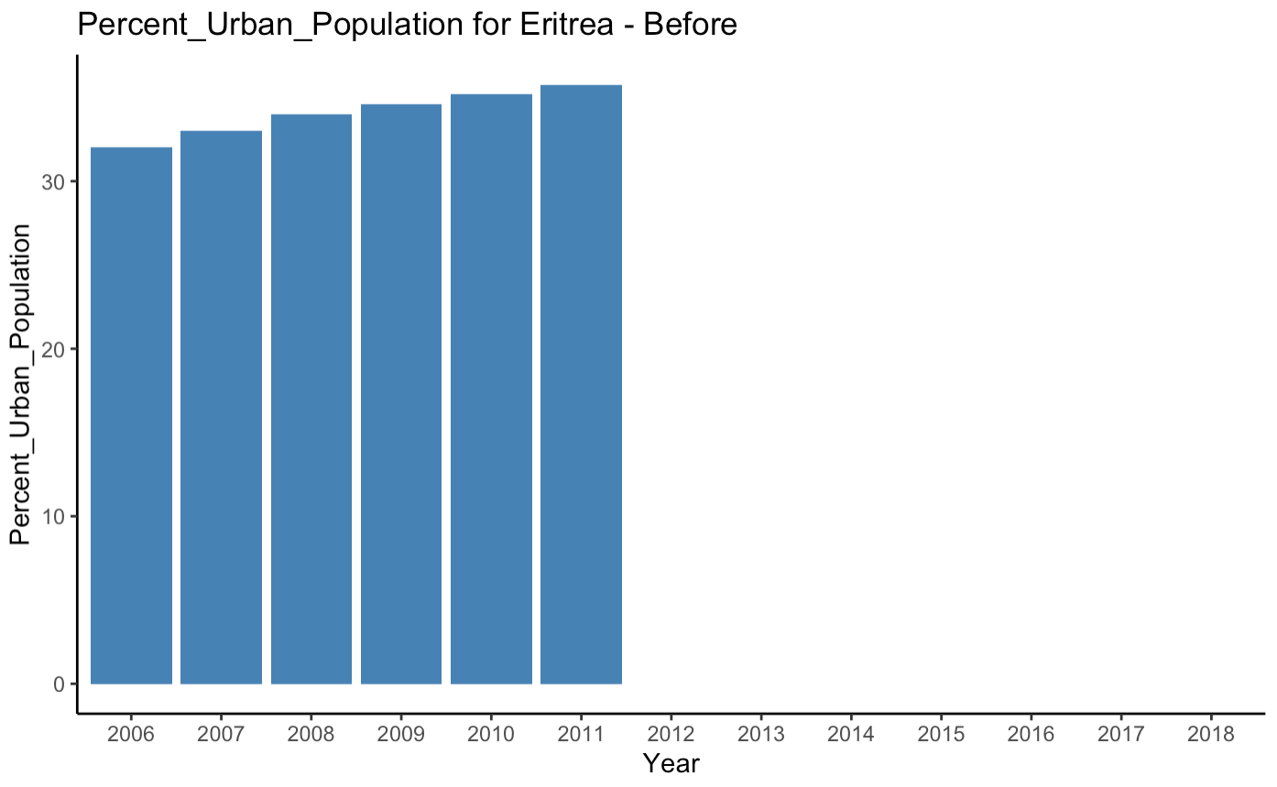
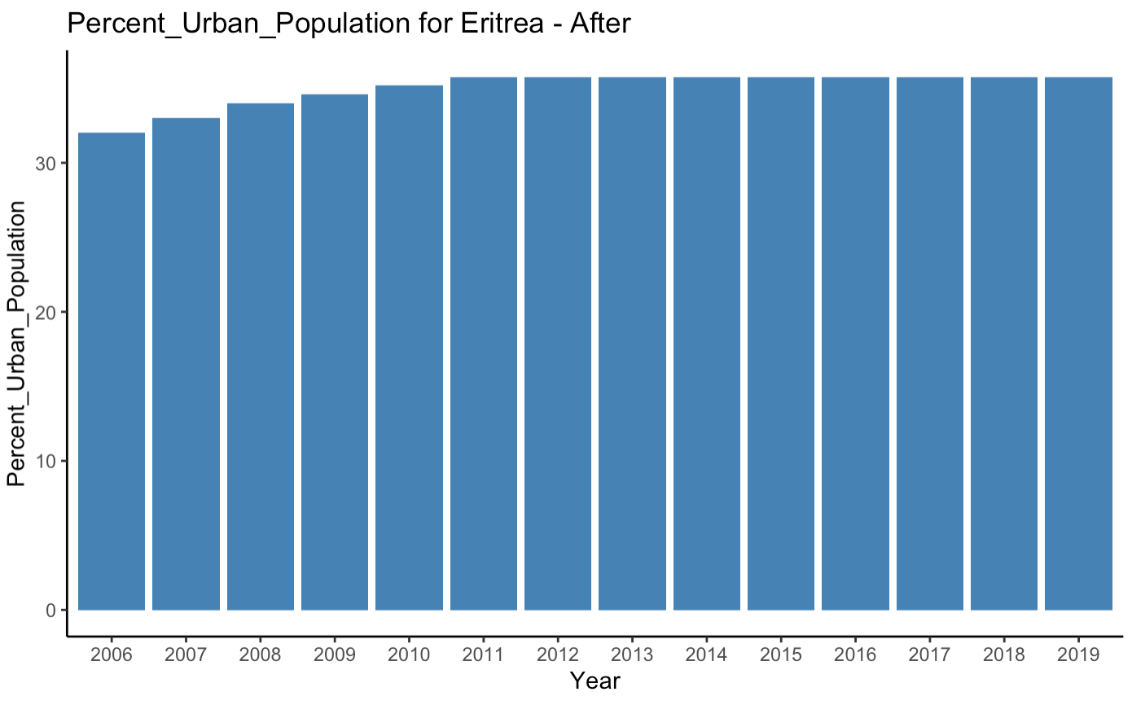
Dealing with missing values
Before (Eritrea)
After (Eritrea)

Slide 7
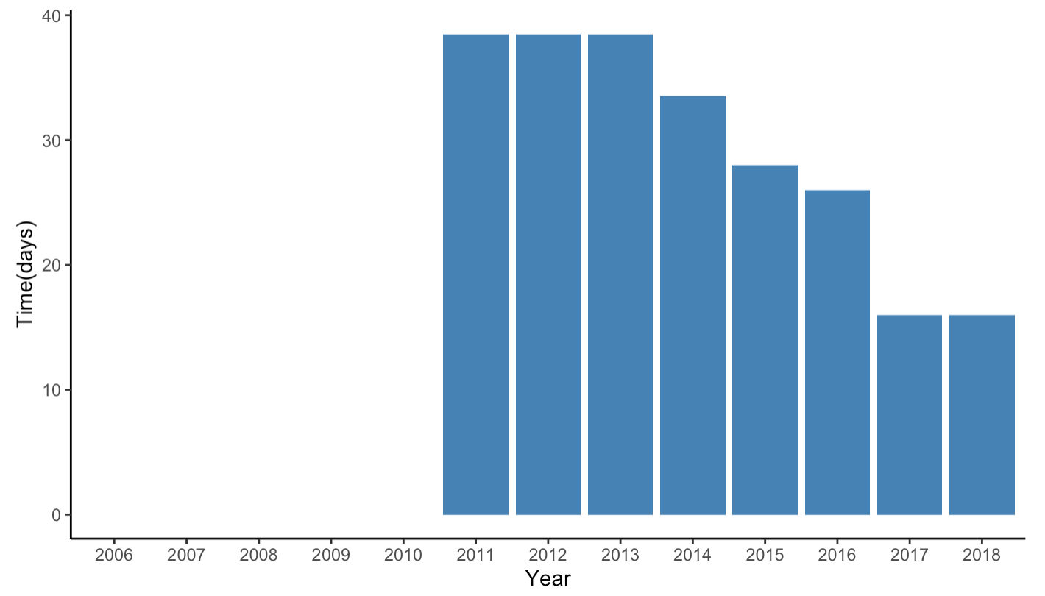
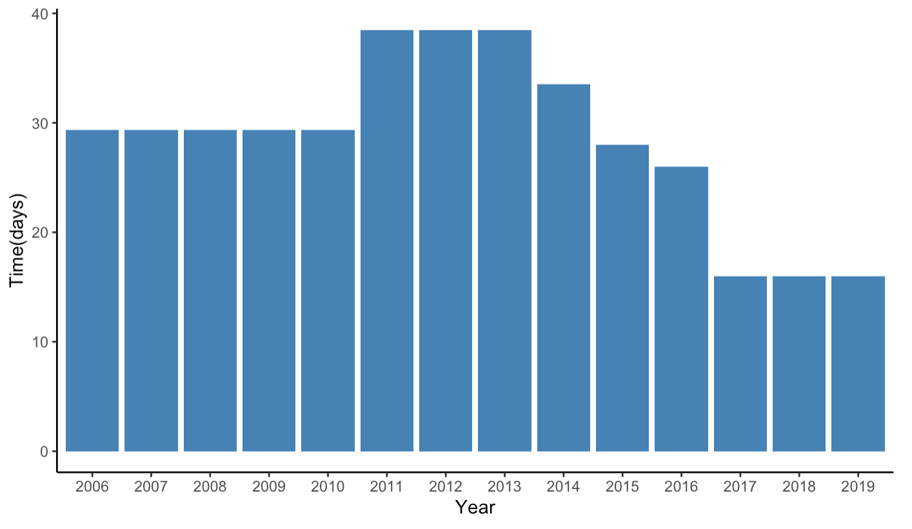
Dealing with missing values
Before (Malta)
After (Malta)

Slide 8
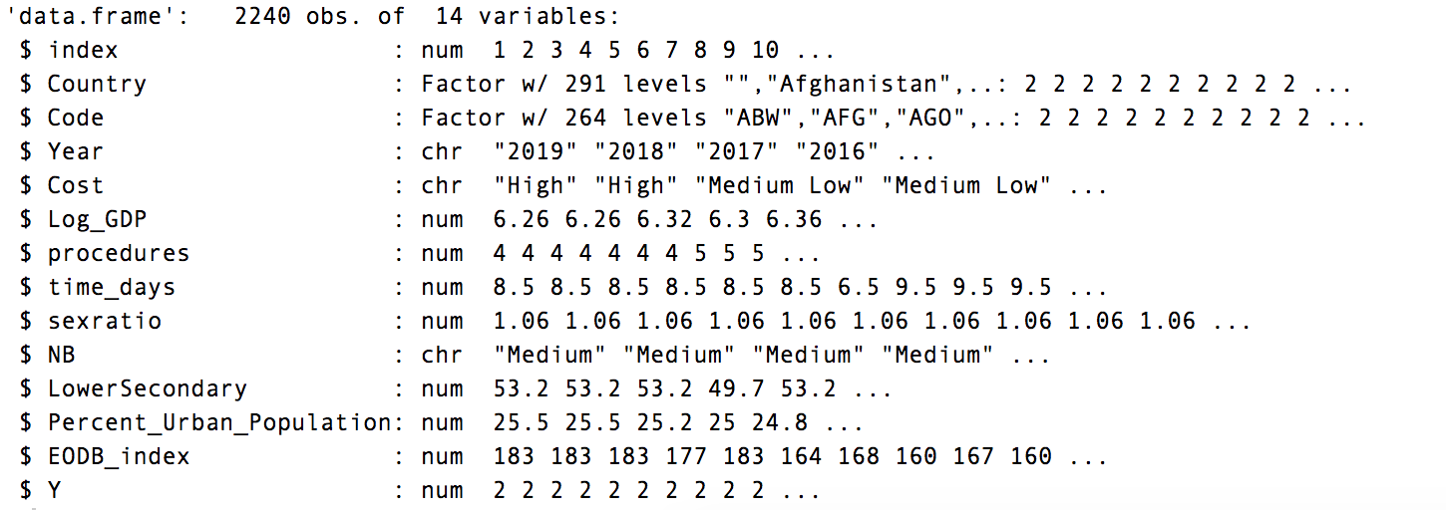
Revised Dataset

Slide 9

Logit Regression

Slide 10
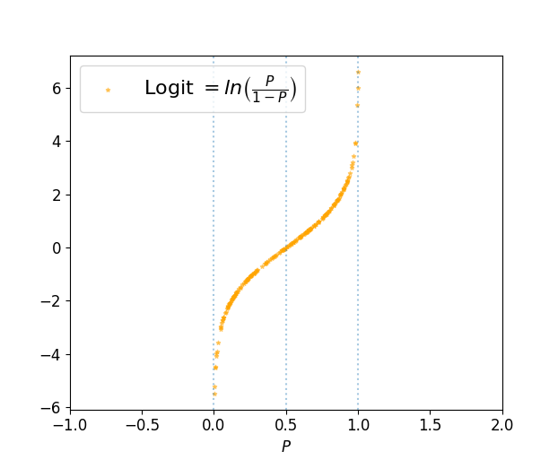
Logit Regression
library(glmnet)
Using the binomial link logit function
Training set: Years 2006-2017
Validation set: Year 2018
 | Predicted
Actual | Easy | Not Easy
Easy | 80 | 6
Not Easy | 31 | 43
Accuracy: 0.76875

Slide 11


Deep
Learning

Slide 12
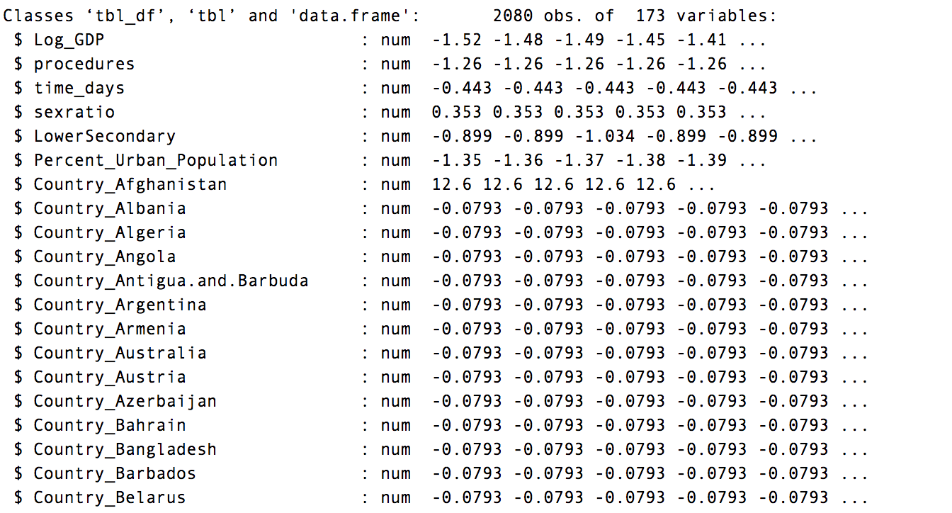
Deep Learning
library(recipe)
Convert categorical predictors into one hot encoding
Center and scale all predictors

Slide 13
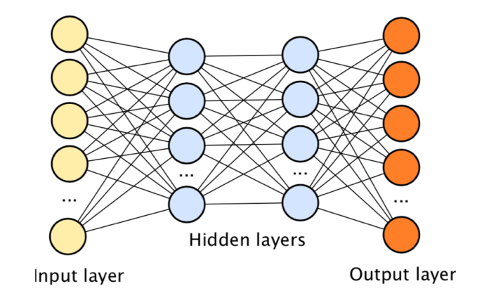

Deep Learning
One hidden layer with 80 units and one output layer with 3 units
The hidden layer uses ReLU activation

Slide 14
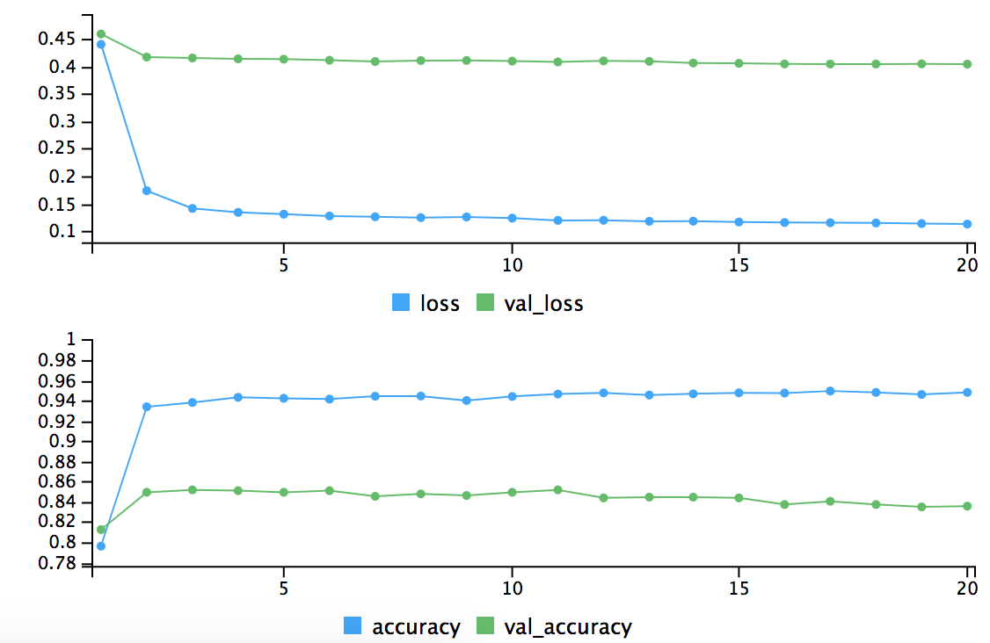
Deep Learning
Compile model with binary cross-entropy loss and adam optimiser
Train the model for training data 2006 - 2017 with 20% validation set

Slide 15
Deep Learning
Predict for the year 2018
 | Predicted
Actual | Easy | Not Easy
Easy | 83 | 3
Not Easy | 15 | 59
Accuracy: 0.8875

Slide 16

Deployed Shiny Application
https://neonflux56.shinyapps.io/EODB/

